Slide 1
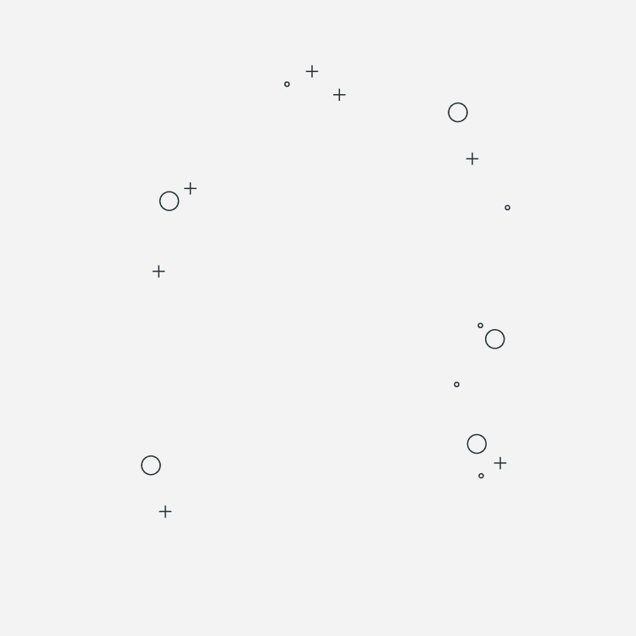

E-COMMERCE
Team 5
“Get the Right Product”

Slide 2
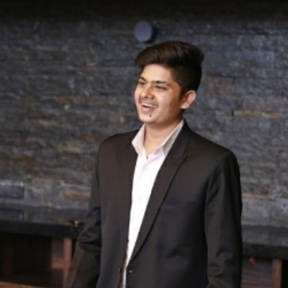

HOW WE WORK
Yash Malviya
Gan-Erdene Benderiya
WORK & WORK
CONTRIBUTION & COLLABORATION
With Agile
Weekly catch-up
Work together
Code
Contribute
Coffee
DEMEANOR
Discussion
Determination
Dynamics

Slide 3
01
INTRODUCTION
02
INTERESTING INSIGHTS
03
CONJECTURES
04
PREDICTION MODEL
05
RECOMMENDATION SYSTEM
06
CONCLUSION

Slide 4
01
INTRODUCTION
02
INTERESTING INSIGHTS
03
CONJECTURES
04
PREDICTION MODEL
05
RECOMMENDATION SYSTEM
06
CONCLUSION

Slide 5

Introduction
Online Retail
UK-based and registered non-store online retail. The company mainly sells unique all-occasion gifts. Many customers of the company are wholesalers.
https://www.kaggle.com/datasets/carrie1/ecommerce-data

Slide 6
MOTIVATION
Why E-Commerce?
Personalized recommendations
Hectic lifestyles
Diverse product options
people have less time to physically visit stores
increase user satisfaction & revenue
result in indecisiveness

Slide 7
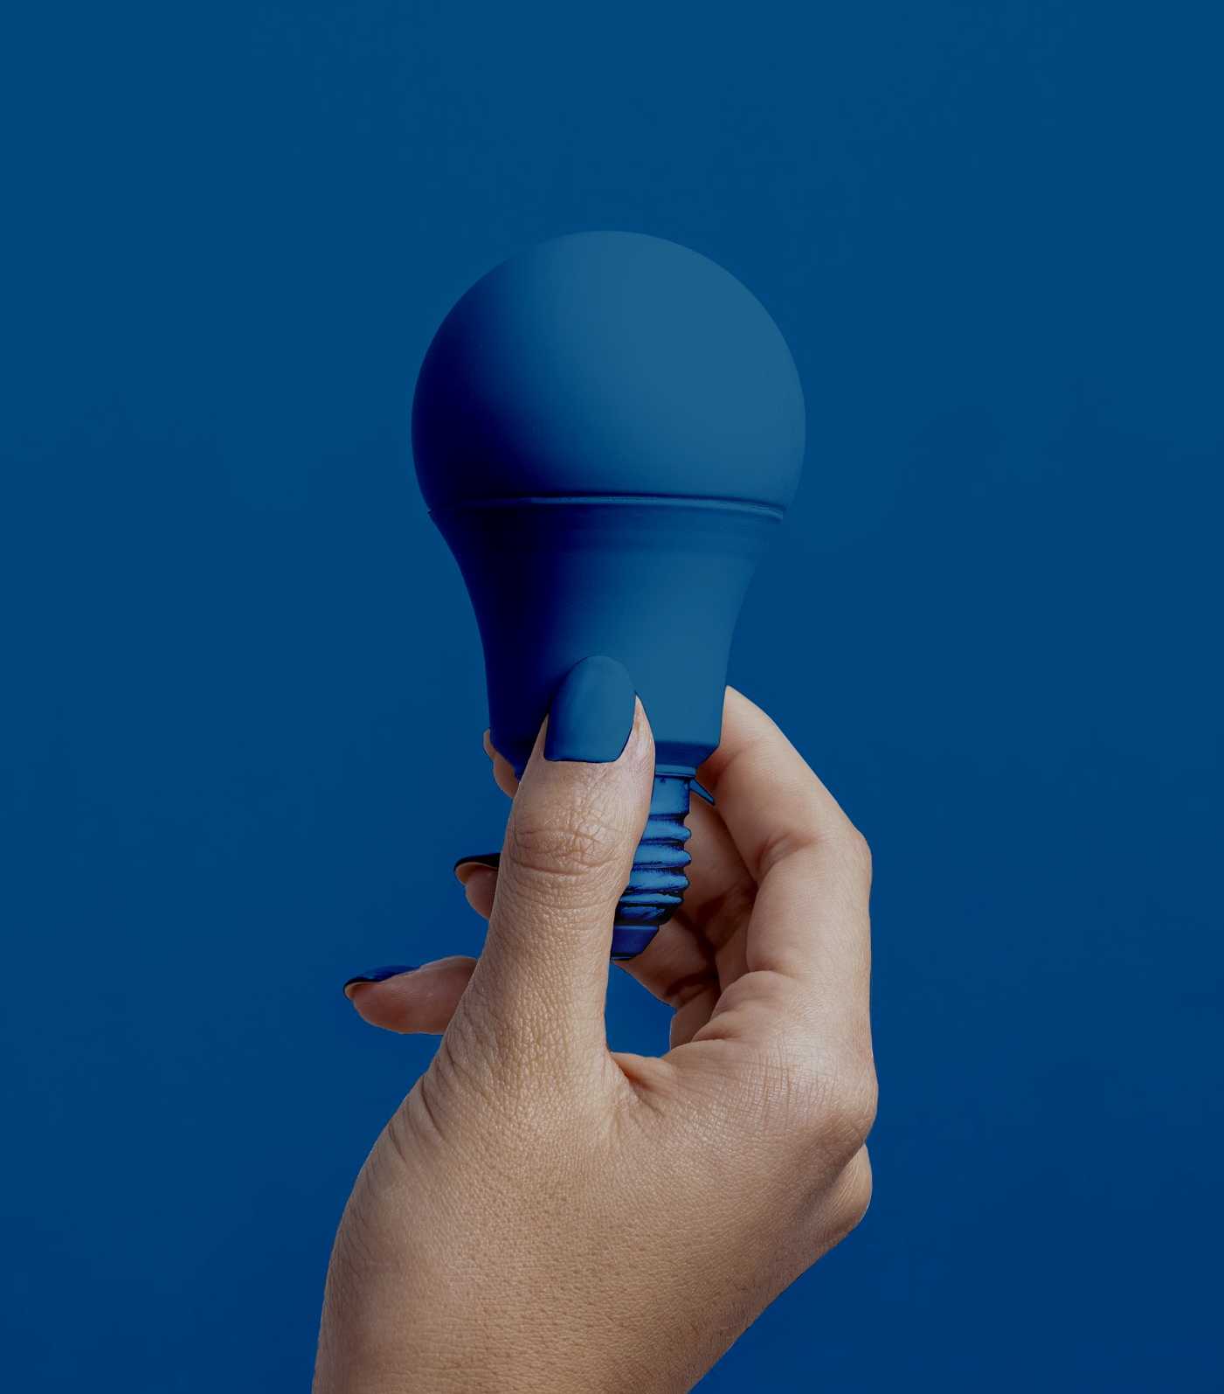
DATA GATHERING & PREPROCESSING
Drop rows that contain duplicates, missing values and anomalies
Key features:
InvoiceNo (transaction identifier)
Stockcode (product identifier)
CustomerID (Customer identifier)
InvoiceDate (transaction Date)
Description (product name)
Country (country)
Quantity (the quantities of each product (item) per transaction)
UnitPrice ()

Slide 8
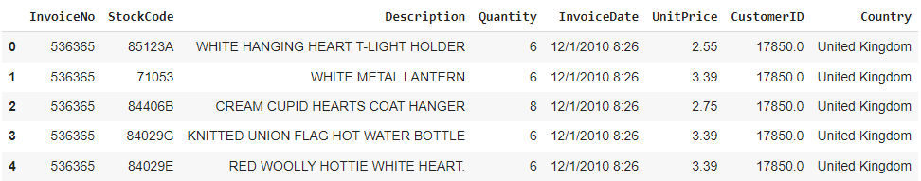
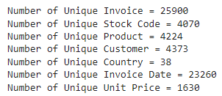
About Dataset
Shape of Data
Completeness
Uniqueness
541909
8
135080
observations
features
CustomerID (Null)
1454
Duplication
Description (null)
5268
Observations

Slide 9
01
INTRODUCTION
02
INTERESTING INSIGHTS
03
CONJECTURES
04
PREDICTION MODEL
05
RECOMMENDATION SYSTEM
06
CONCLUSION

Slide 10
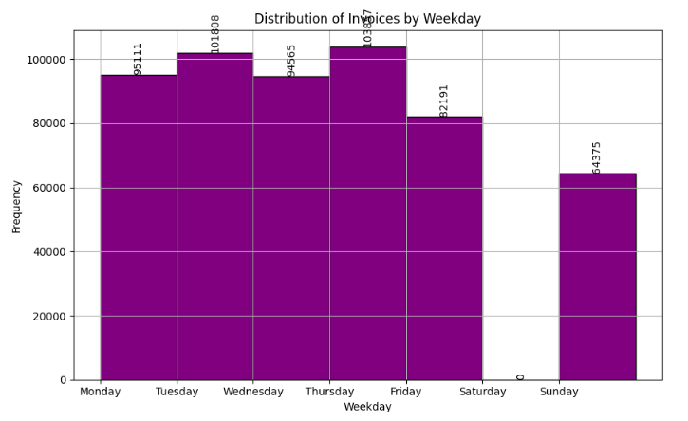
Interesting Insights
Most orders are placed on Thursday & Tuesday

Slide 11
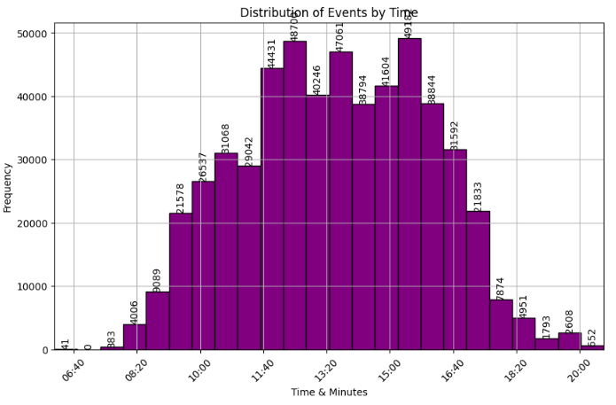
Interesting Insights
Most orders are placed between 11:40 to 16:40

Slide 12
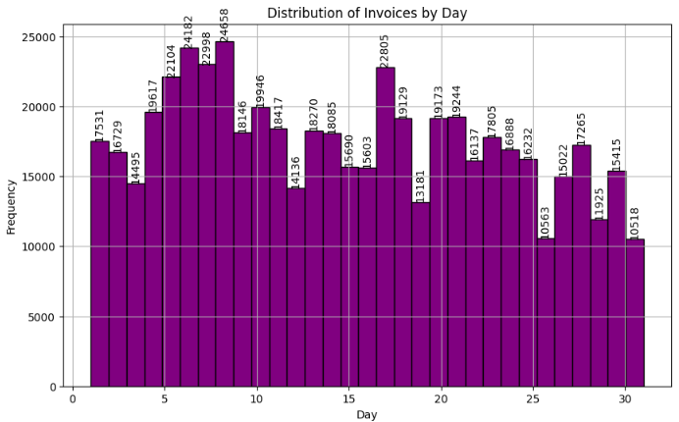
Interesting Insights
Most orders are placed between 5th to 10th of the month

Slide 13
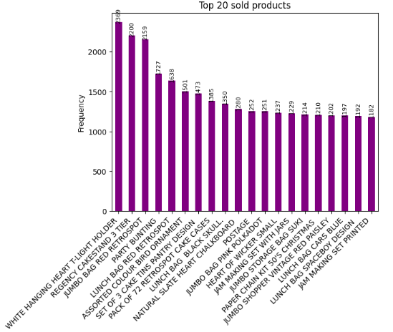

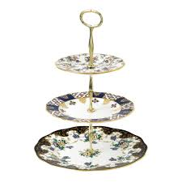

Interesting Insights
Most popular products are:
White Hanging heart t-light holder
Regency cakestand 3 tier
Jumbo bag red retrospot
Party bunting

Slide 14
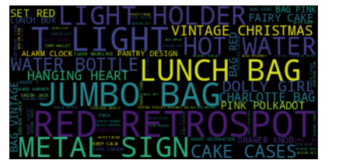
Interesting Insights
User preference
RED RETROSPOT
JUMBO BAG
METAL SIGN
LUNCH BAG
LIGHT HOLDER
VINTAGE CHRISTMAS

Slide 15
01
INTRODUCTION
02
INTERESTING INSIGHTS
03
CONJECTURES
04
PREDICTION MODEL
05
RECOMMENDATION SYSTEM
06
CONCLUSION

Slide 16
Conjectures
There could be significant increase in sales activity towards the end of the year due to the holiday season.
Sales are consistently high throughout the day with no significant hourly fluctuations.
.

Slide 17
01
INTRODUCTION
02
INTERESTING INSIGHTS
03
CONJECTURES
04
PREDICTION MODEL
05
RECOMMENDATION SYSTEM
06
CONCLUSION

Slide 18
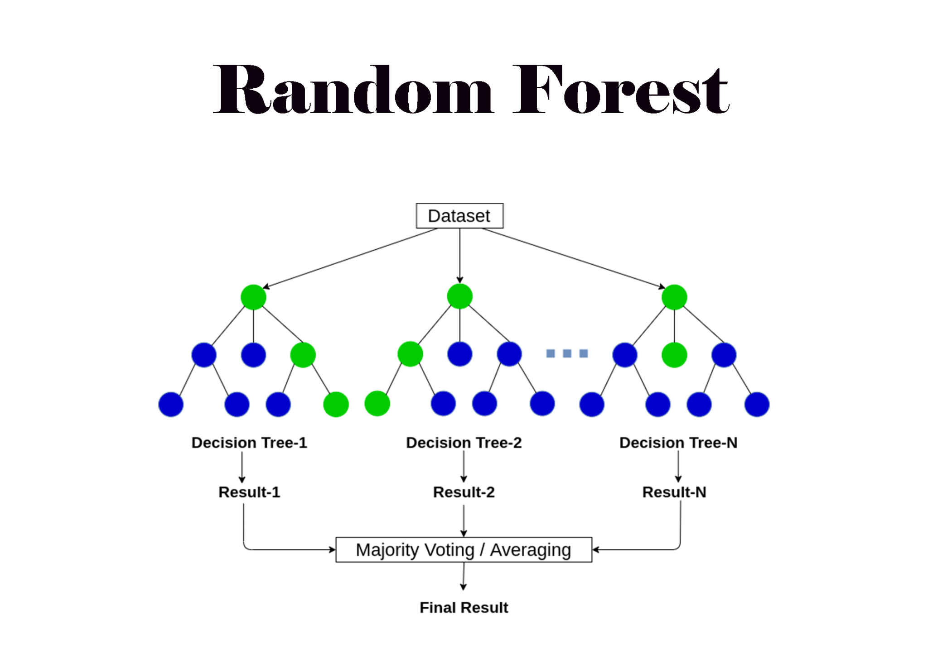
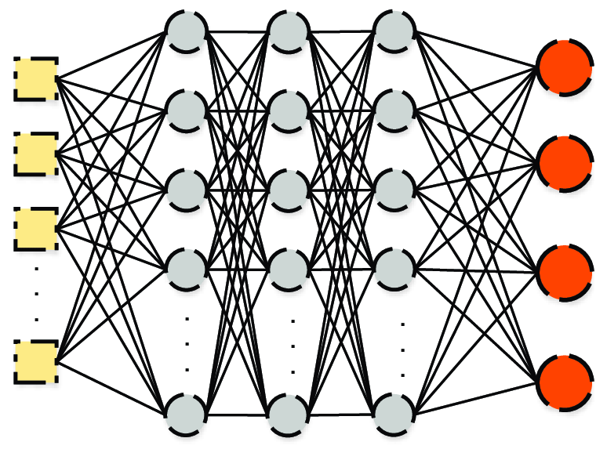
Regression Task
Regression for forecasting e-commerce sales and determining optimal product selling times.
Random Forest (with Baseline Vs Hyperparameter tuned model)
Sequential Deep Learning Model

Slide 19
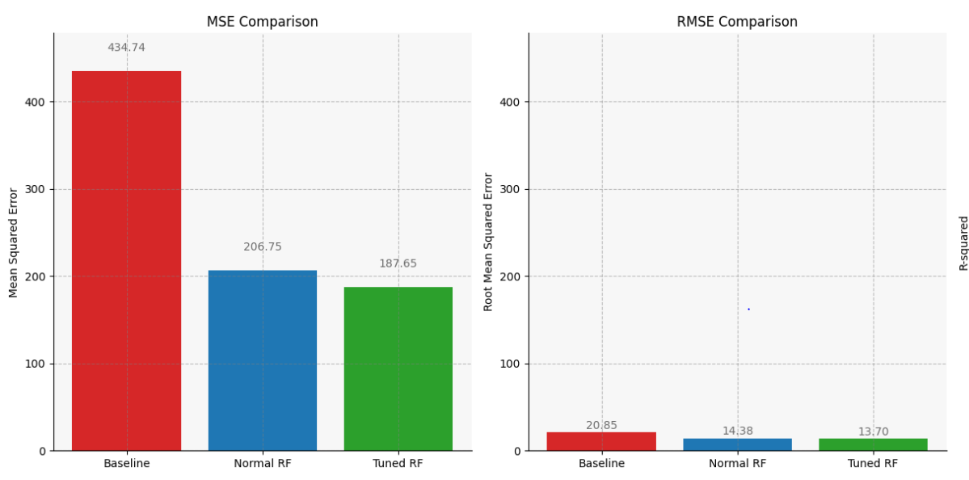

Random Forest
Evaluation Metrics : MSE & RMSE
Base Line MSE :

Slide 20
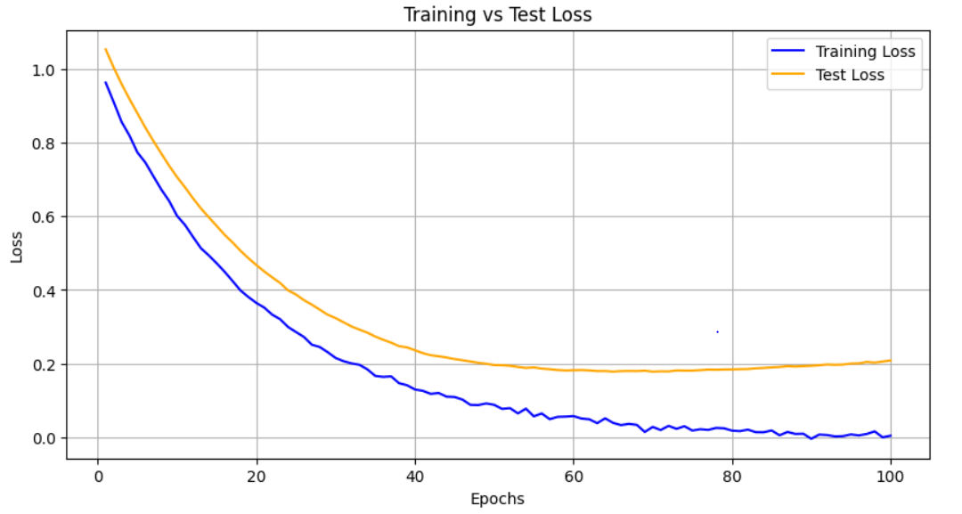
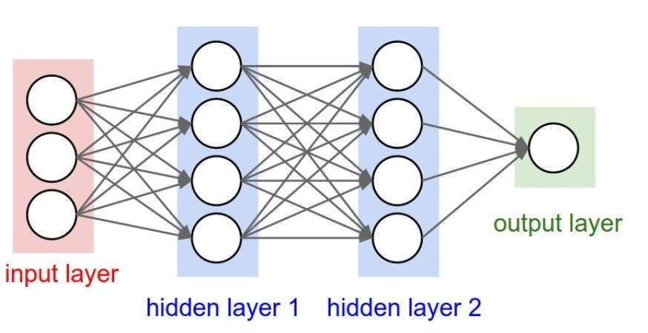

Sequential Model
This model turned out to be very good in terms of Performance.
Train Loss : 0.16
Test Loss : 0.23

Slide 21
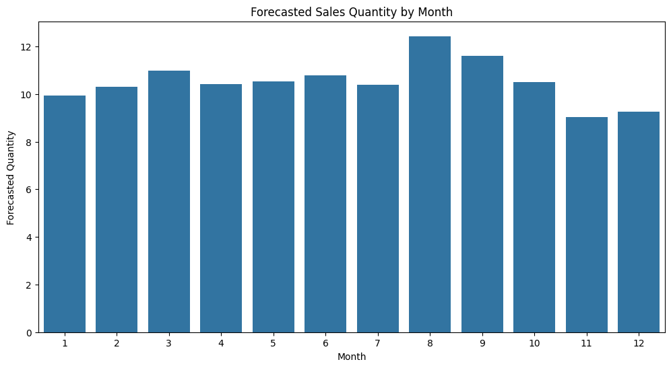

Forecasting Sales
Mid-Year Peak: peak in sales around the 9th month, which suggests that there is higher consumer activity . This could be associated with back-to-school shopping or seasonal promotions.
End-of-Year Decrease: Post the peak, there's a decline in forecasted sales towards the end of the year, with the lowest point in December..

Slide 22
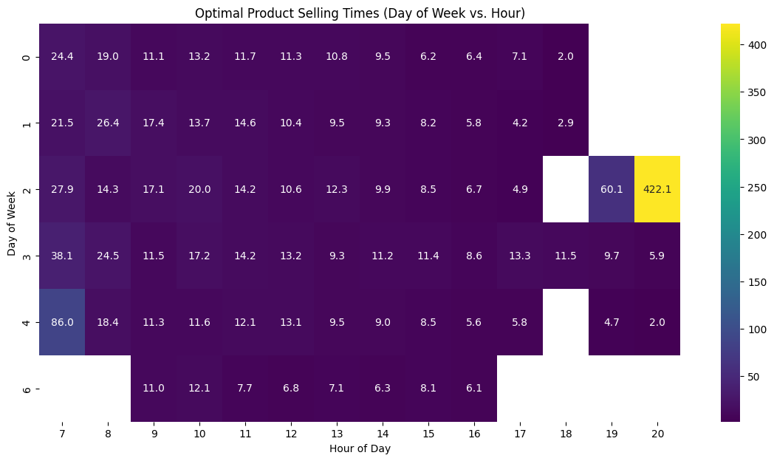

Optimal Selling times
There's a time slot with sales reaching 422.1 units which occurs on the 3rd day ( wednesday ) of the week at the 19th hour. This

Slide 23
01
INTRODUCTION
02
INTERESTING INSIGHTS
03
CONJECTURES
04
PREDICTION MODEL
05
RECOMMENDATION SYSTEM
06
CONCLUSION

Slide 24


Product Recommendation System
WHITE HANGING HEART T-LIGHT HOLDER
Used scikit learn.sparse csr_matrix to generate a user-product map
Fed data from the csr_matrix into a KNN network which used 5 neighbors and a cosine similarity metric
The input for the model is a StockCode
The output is (Description) product names that are similar to the input stock code determined by the ML algorithm
Since you bought a WHITE HANGING HEART T-LIGHT HOLDER, here are some similar options:
RED HANGING HEART T-LIGHT HOLDER
CANDLEHOLDER PINK HANGING HEART
NATURAL SLATE HEART CHALKBOARD
HEART OF WICKER SMALL

Slide 25
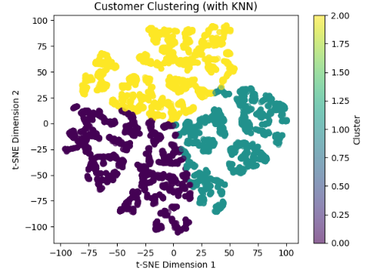
Customer Clustering
35%
50%
Knn=3
Software
Designers

Slide 26
01
INTRODUCTION
02
INTERESTING INSIGHTS
03
CONJECTURES
04
PREDICTION MODEL
05
RECOMMENDATION SYSTEM
06
CONCLUSION

Slide 27
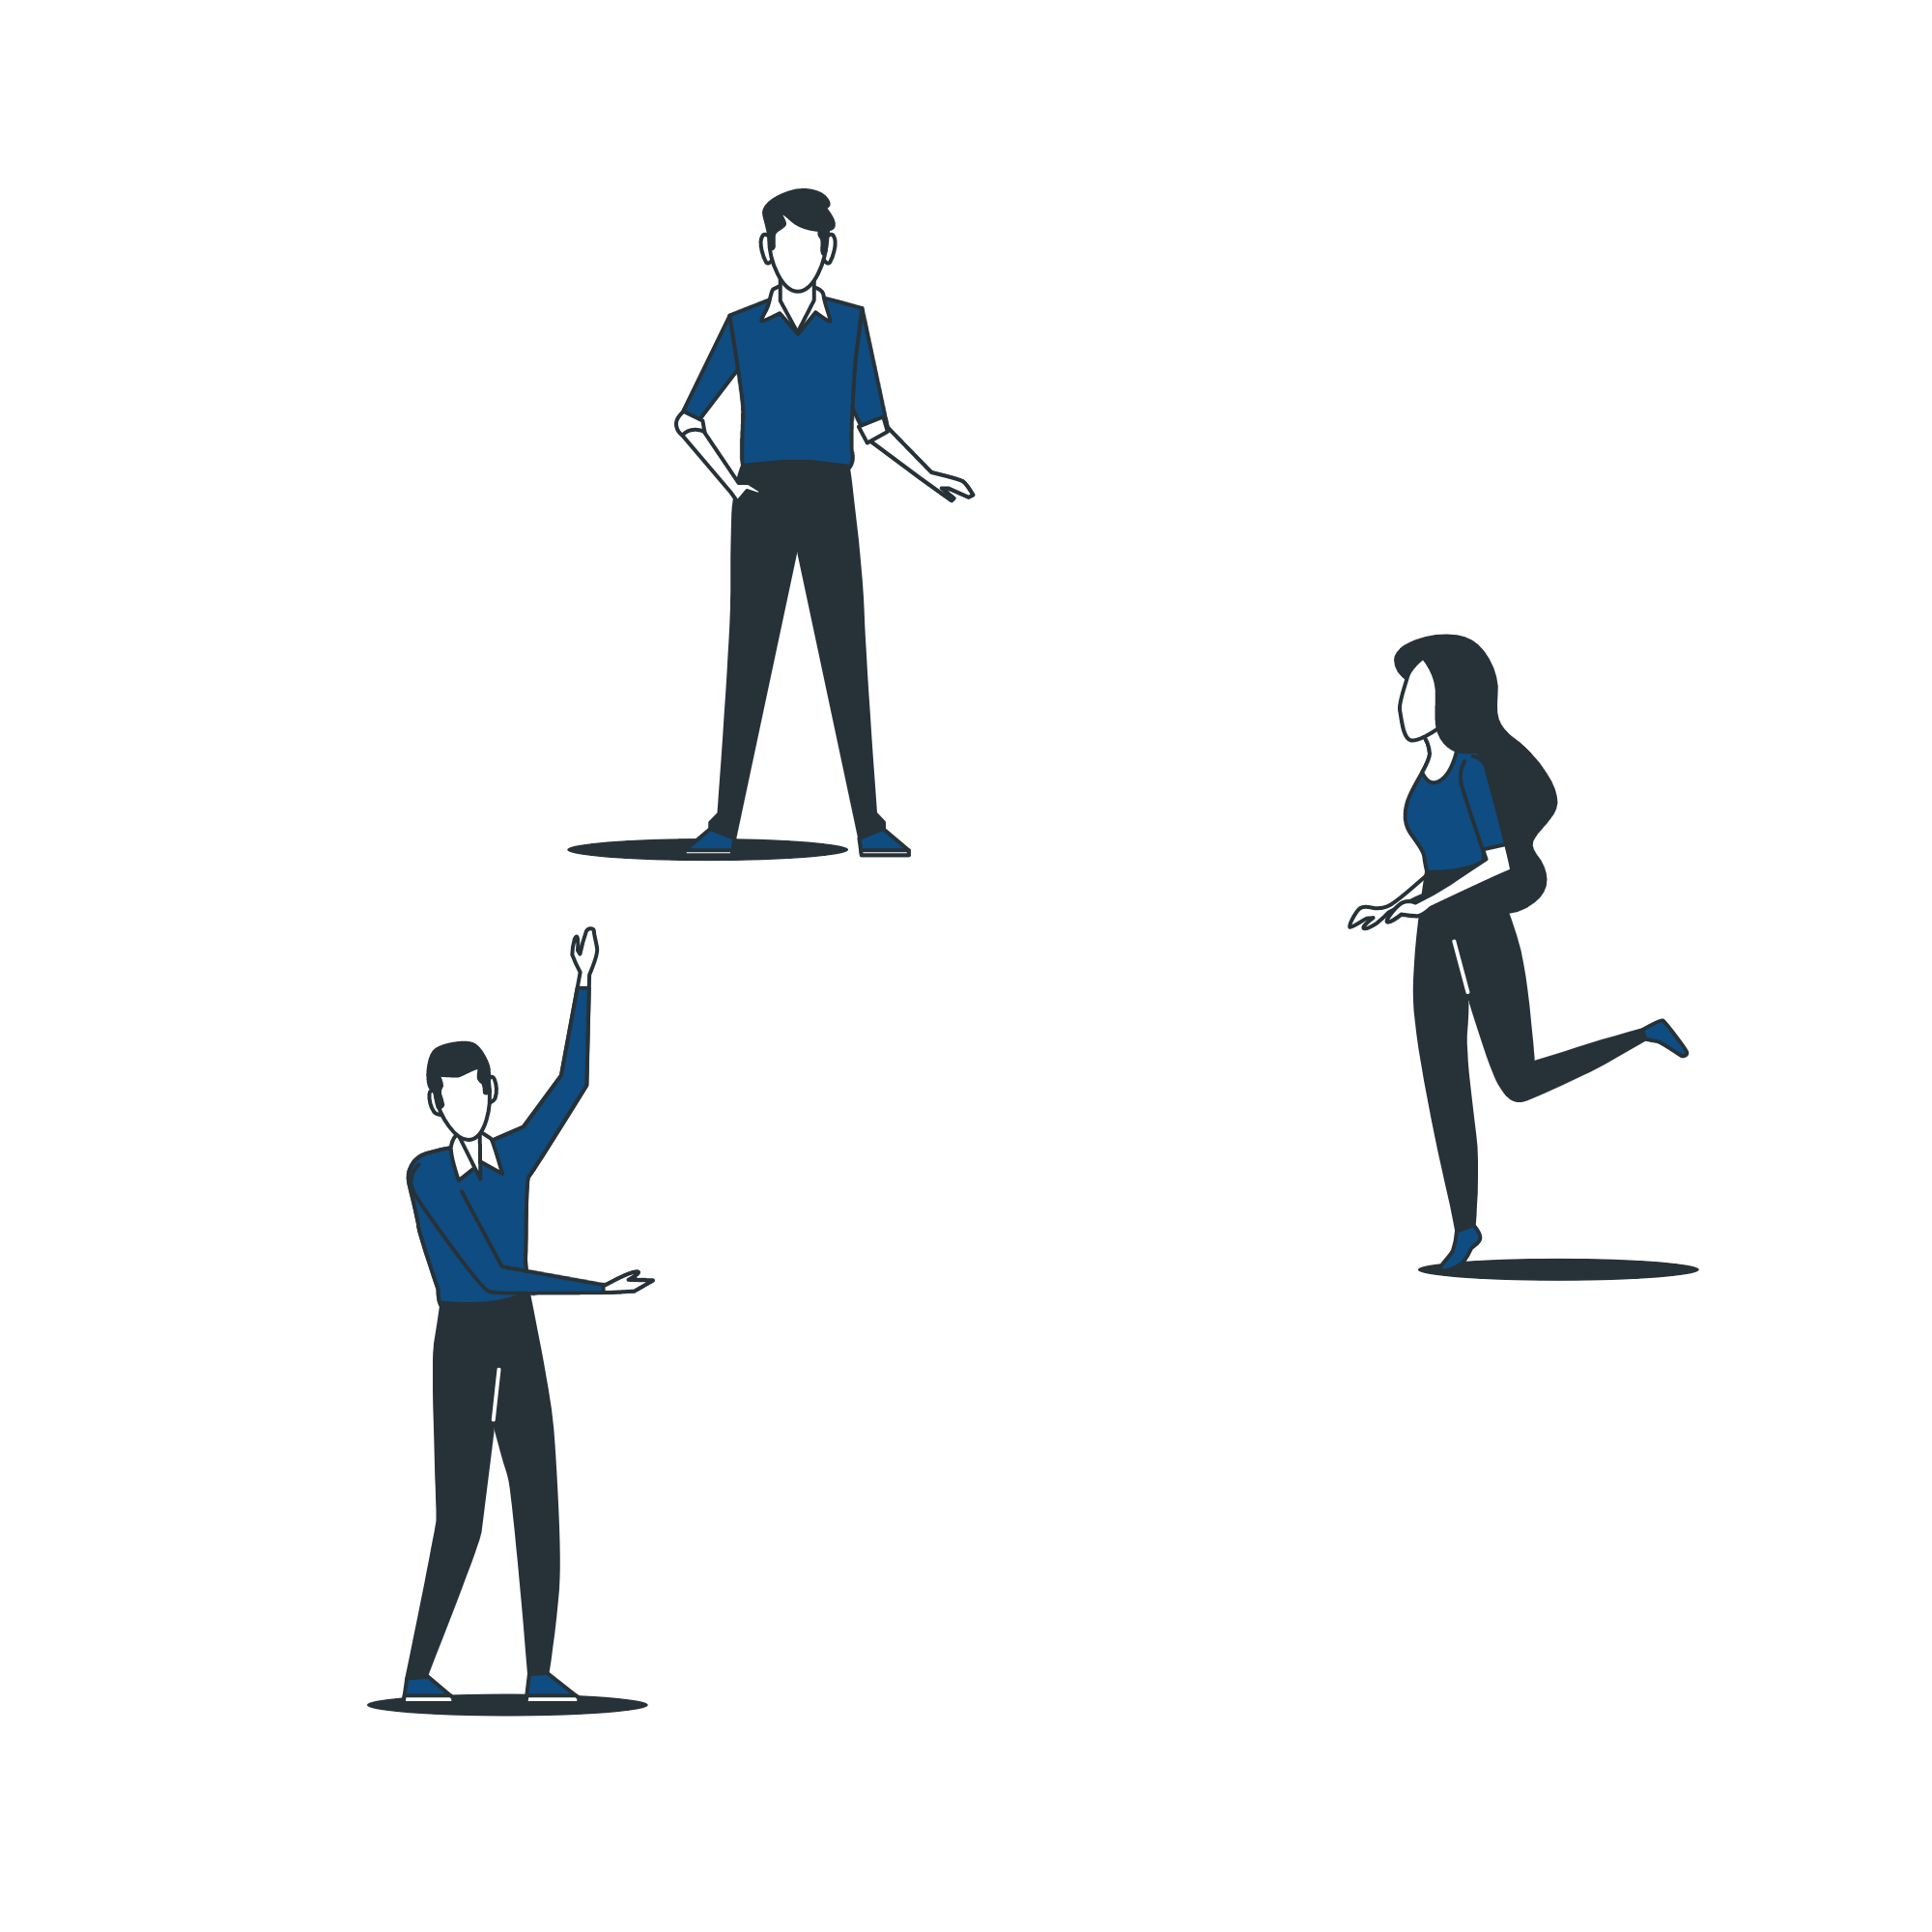
BUSINESS IMPACT
Increase satisfaction
Increase user satisfaction by observing their behavior based on the transaction and define pattern
Increase profit
Increase sales by recommending the right product for the right person at the right time
Save Cost
Save marketing costs
Improve internal logistics

Slide 28
CHALLENGES
ORIGINALITY
COMPUTATIONAL RESOURCE
Come up with fresh insights
Used colab
SCHEDULE
Using Agile, but still challenging

Slide 29

How would you work on if you were us?
What would you do differently?
What conjectures would you come up?
What problems you would tackle?
What models would you choose?
What would be the potential impact of your result?
?

Slide 30
THANKS FOR THE TIME
Acknowledgement: slidesgo template is used

